Slide 1
How to assign specified value to each element of an array?
momedaram

Slide 2
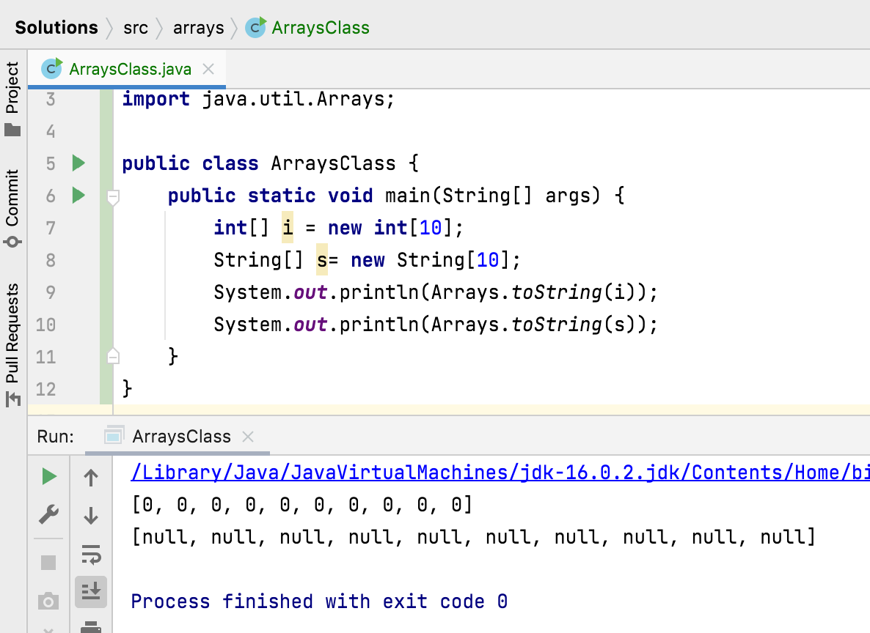
How to assign specified value to each element of an array?
Arrays.fill() - assigns specified value to each element of an array.

Slide 3
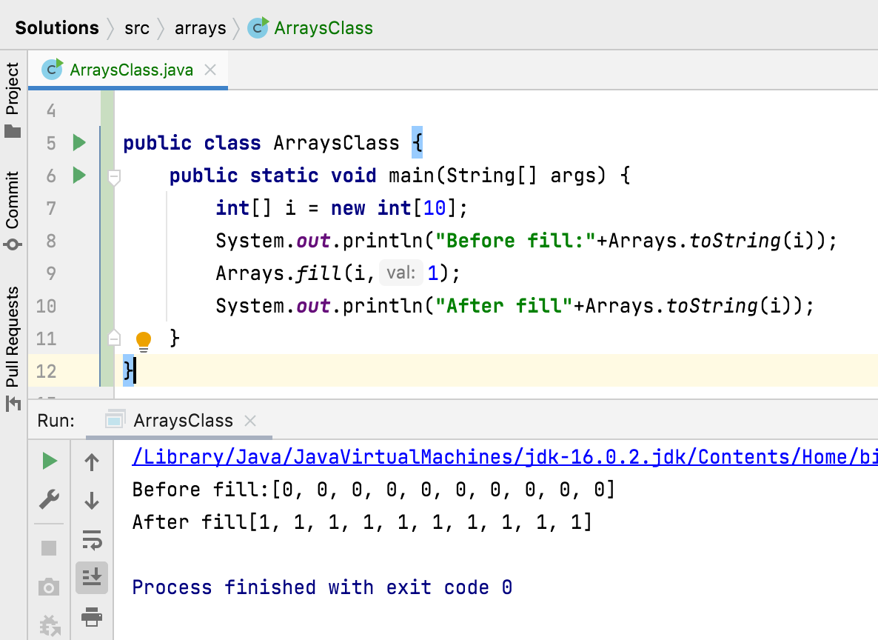
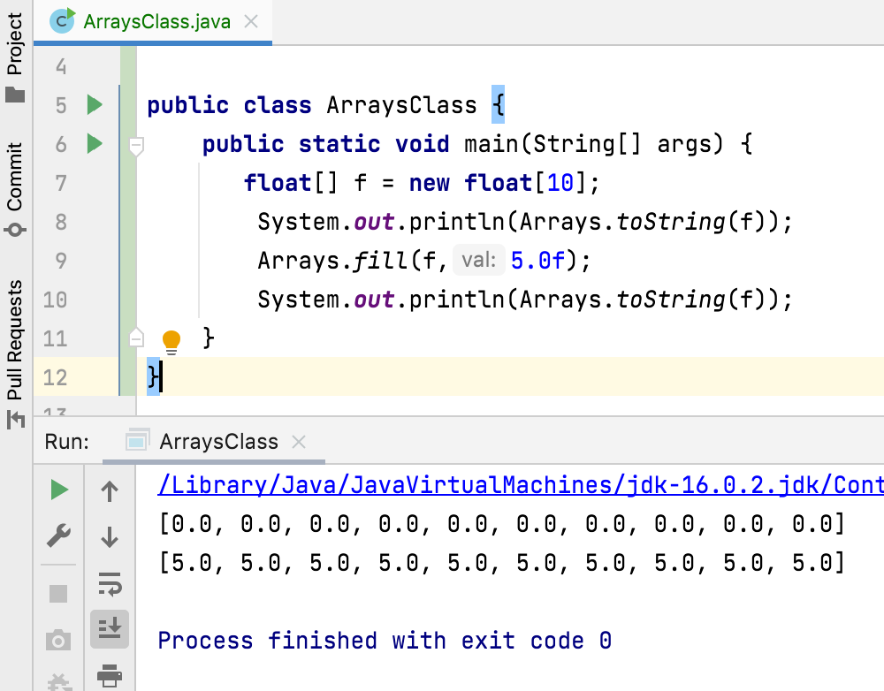

Slide 4
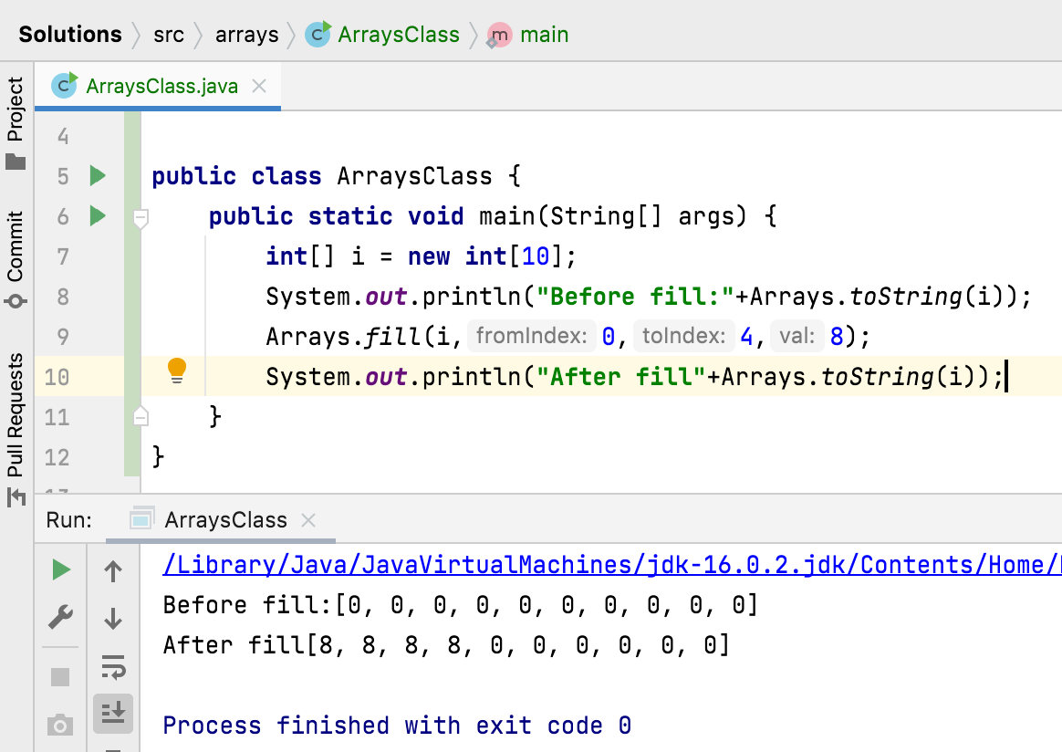
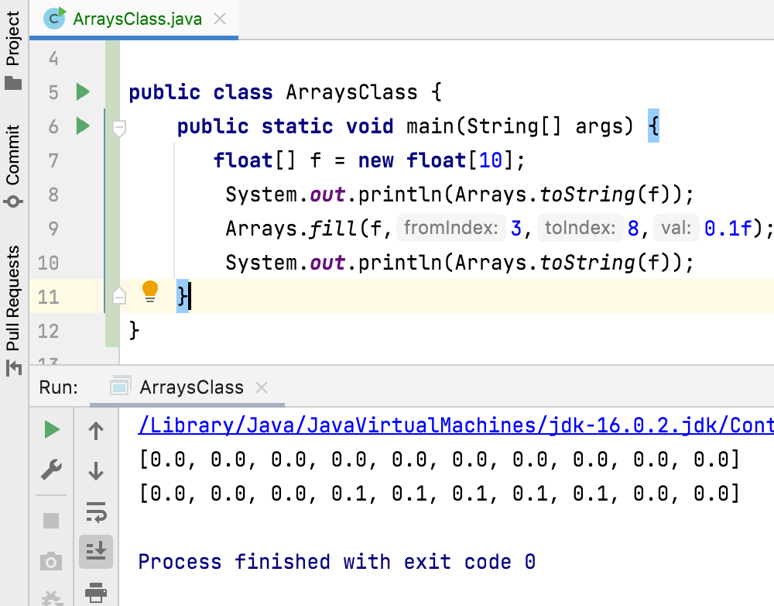

Slide 5
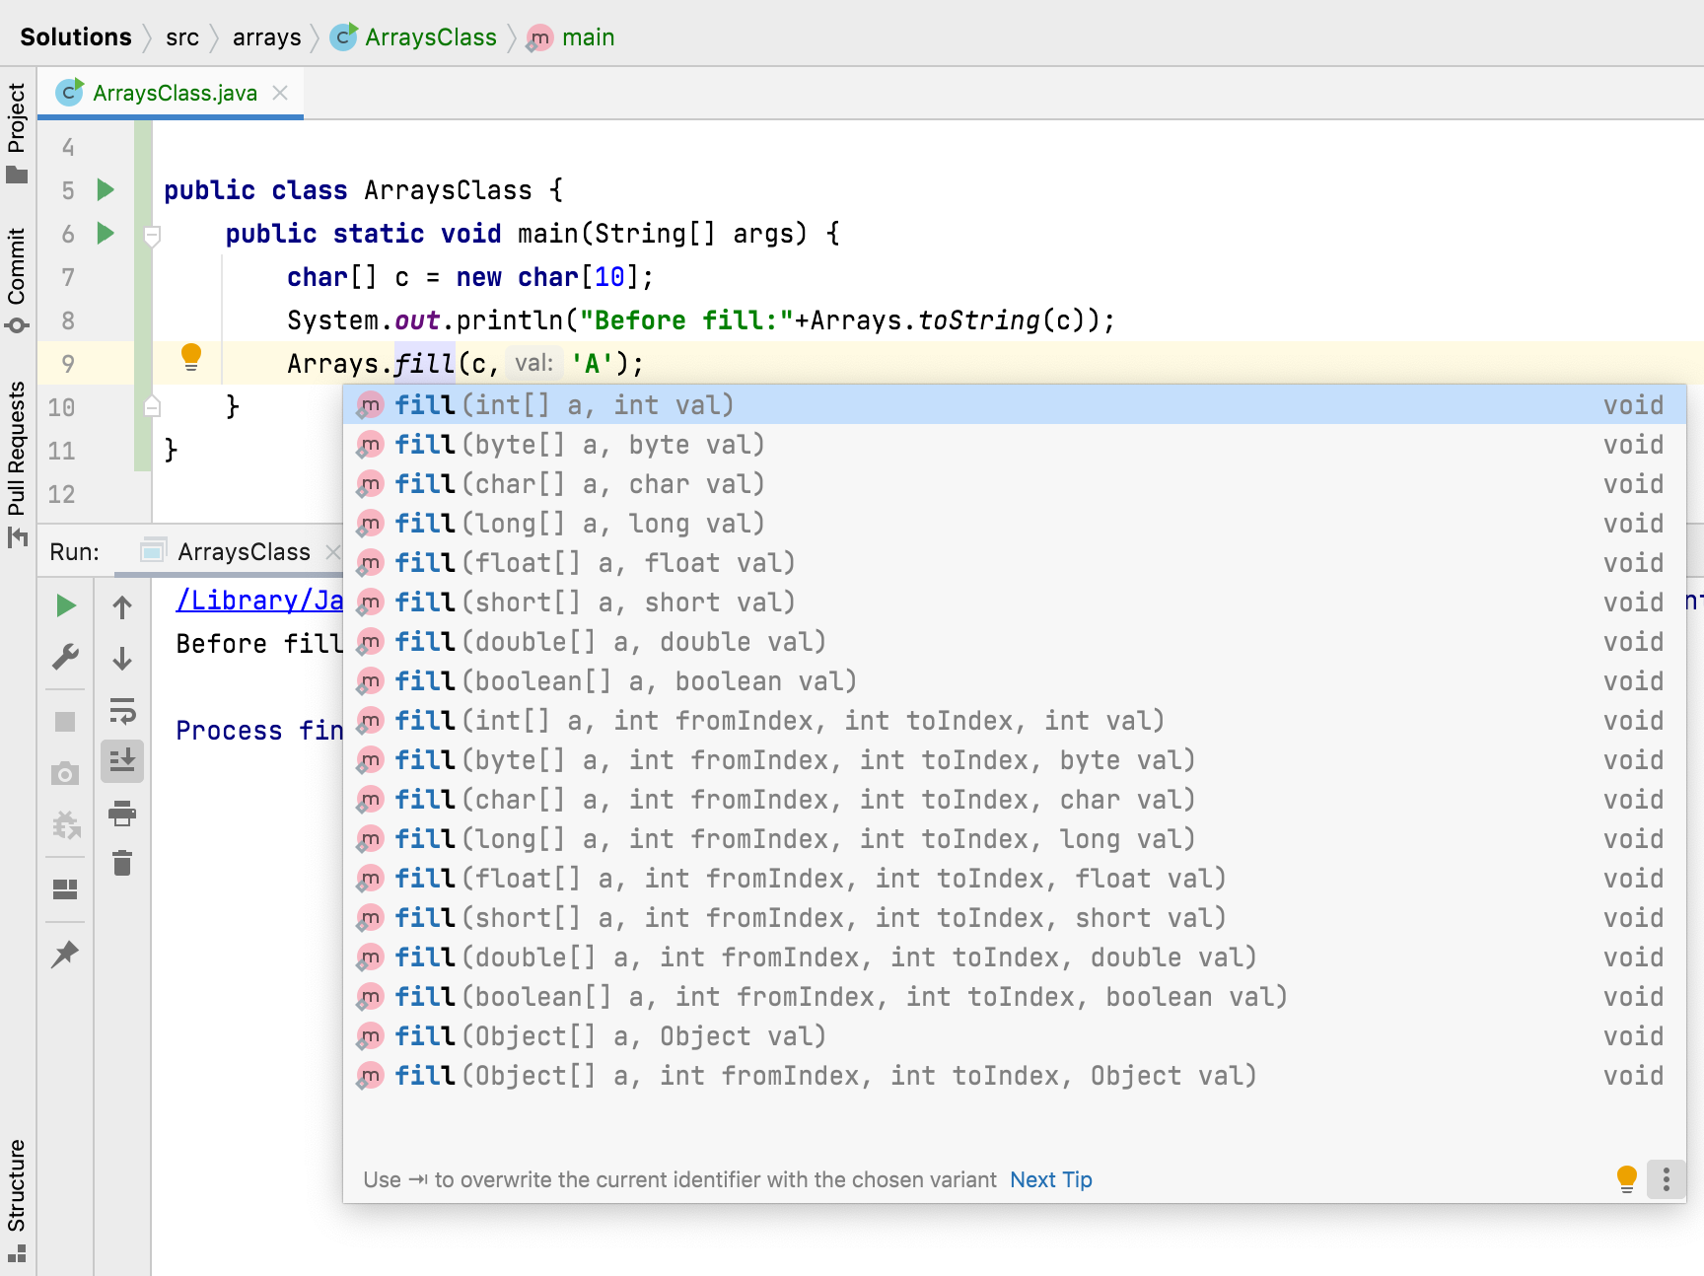

Slide 6
How to assign specified value to each element of an array?
Arrays.fill(a[], value)
Assigns the specified value to each element of the specified array of elements.
Arrays.fill( a[] , int fromIndex, int toIndex, value)
Assigns the specified value to each element of the specified range of the specified array.
may throws:
IllegalArgumentException – if fromIndex > toIndex
ArrayIndexOutOfBoundsException – if fromIndex < 0 or toIndex > a.length

